Slide 1

Integrating Lamport’s One Time Password
Authentication Scheme with Elliptic Curve
Cryptography
TEAM MEMBERS: ANAND KUMAR(1PI12IS013)
SUMIT KUMAR(1PI12IS114)
GUIDE NAME:
ASST. PROF. RAJ ALANDKAR
Dept. of ISE,PESIT
Notes:
<number>

Slide 2
Problem Statement
Establishing end-to-end authentication between devices and applications
Existing authentication mechanisms are vulnerable to security threats and can disrupt the progress
Dept. of ISE,PESIT

Slide 3
Objective and Scope
Objective of this project is address the challenges and issues found in the existing aunthentication process
We propose an authentication scheme integrating Lamports One time password with Elliptic Curve Cryptography
Dept. of ISE,PESIT

Slide 4
Introduction
Discovered in 1985 by Victor Miller (IBM) and Neil Koblitz (University of Washington)
Shorter keys requires less CPU consumption and memory utilization
It is as stronger as other cryptographic systems with larger keys
Can be used for Encryption, Digital Signature, pseudo random generators, and other tasks
Dept. of ISE,PESIT
Notes:
<number>

Slide 5
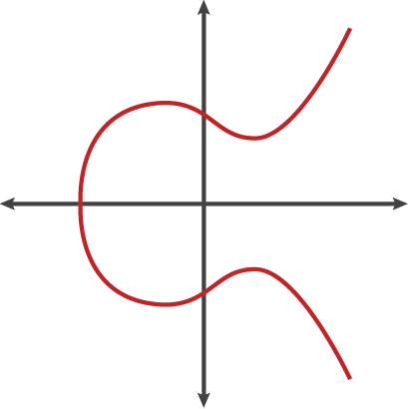
ECC Equation
Curve is symmetric to X axis
It follows Group operations
Dept. of ISE,PESIT

Slide 6
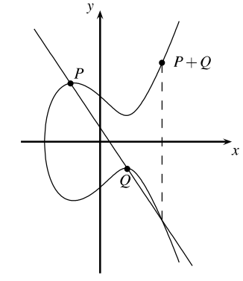
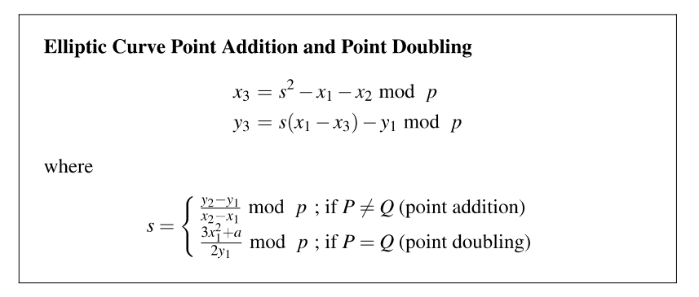
Group Operation on Elliptic Curves :
Dept. of ISE,PESIT

Slide 7
Key generation : An important part where we have to generate both public key and private key. The sender will be encrypting the message with public key and the receiver will be decrypting it with its private key.
Private Key Generation :
Randomly select the private key, such that it is relatively prime to p :
-------------------------------------------------------------------------------------------------------------------------------
BigInteger privateKey;
do
{
privateKey = new BigInteger(p.bitLength(), rnd);
}
while (privateKey.mod(p).compareTo(BigInteger.ZERO) == 0);
Dept. of ISE,PESIT

Slide 8
Public Key Generation :
Calculate the public key = privateKey * g .
------------------------------------------------------------------------------------------------------------------
ECPoint g = c.getBasePoint();
ECPoint publicKey = c.multiply(g, privateKey);//scalar multiplication using double and add algorithm
Dept. of ISE,PESIT

Slide 9
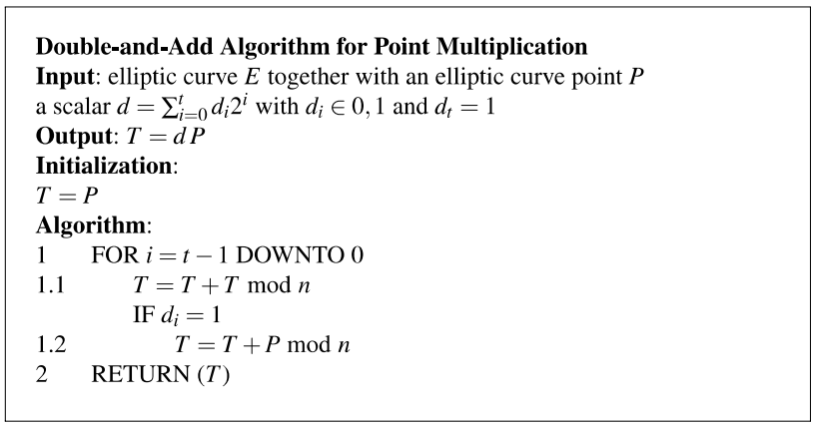
Dept. of ISE,PESIT

Slide 10
CLIENT
Register Listener
Register Service
Data Access Operations Layer
- Read username and password
- Valid if they are proper
- Invoke the service
- return
Login
Service
SERVER
USER INTERFACE
Login Listener
- Read username and password
- Valid if they are proper
- Invoke the service
- If valid user, then create the session
- return
DATABASE
Dept. of ISE,PESIT

Slide 11
CLIENT
SERVER
Specifies the server IP address and the port number to which the server is listening to
Specifies the server port number to listen
Socket stream where the data transmission takes place
Dept. of ISE,PESIT

Slide 12
Encryption requires public Key and message
Block[] is converted to BigInt, so characters written in their ASCII form
After putting this BigInt as X in our ecc equation we will get the corresponding Y
So, our message is now encoded into a ECPoint(a point on the graph), and we store it as (X,Y)
Block contains content of padded message
Encode each block into unique point.
ECPoint[] encoded = new ECPoint[block.length];
for (int i = 0; i < encoded.length; ++i)
{
encoded[i] = encode(block[i], c);
}
Dept. of ISE,PESIT

Slide 13
Encrypt each encoded point into a pair of points[C_1,C_2]
[C_1, C_2] = [kG, P_m + kP_G],
k is a randomly generated integer such that 1 <= k < p-1,
G is the base point ,
P_m is the encoded point from the plain text,
P_G is the point provided in the public key.
Dept. of ISE,PESIT

Slide 14
Decryption :
We have to get back the message ‘M’ that was sent to us
M=C2-k*C1
Calculate the encoded point(point on the graph)
P_m = C_2 - kC_1, where:
[C_1, C_2] is the cipher text(we received)
k is the private key.
Decode the encoded point, and the message is decrypted back to original message.
Dept. of ISE,PESIT

Slide 15
Encryption Process:
Let ‘m’ be the message that we are sending. We have to represent this message on the curve.
Consider ‘m’ has the point ‘M’ on the curve ‘E’. Randomly select ‘k’ from 1 to n-1.
Two cipher texts will be generated. C1 and C2
C1 = k*P
C2 = M + k*Q
Decryption Process:
We have to get back the message ‘m’ that was sent to us.
M = C2 – d*C1
M is the original message that we have used.
Proof:
M = C2 – d*C1
= (M + k*Q) – d (k*P)
= M + k*d*P – k*d*P
= M
Dept. of ISE,PESIT

Slide 16
Lamport's OTP
Client Server
Example
f(1) = 242.5
f(2) = 592.75 f(3)=1118.125
f(4)=1906.1875
f⁻¹(2) = 242.5 f⁻¹(3)=592.75
f⁻¹(4)=1118.125
Lamport function
Lamport inverse function
f(x) = (3n + 3+f) / 2
f⁻¹(x) = (2*f(x) -3 -f) / 3
Where
n is called seed – an initial value(here 9)
f is the factor – different for different client session(455)
Dept. of ISE,PESIT

Slide 17
Conclusion:
Messages are sent across the server and client in an encrypted way and the other side is able to read it.
Able to generate public and private keys through elliptical curves which are helping us to encrypt the messages across server and client.
With Help of Lamport's OTP scheme server keeps a track on the client to which it is connected to.
With shorter key sizes still the same amount of security has been achieved.
Dept. of ISE,PESIT

Slide 18
Where we faced Problems:
We faced problem to do group operation on curve which is mandatory for getting the publicKey from the elliptic curve
Mapping of messages to the elliptic curve in order to have encoded point on the curve which denotes our messages
Dept. of ISE,PESIT

Slide 19
Future Work
Currently this algorithm is genrating keys for NIST_P_192 , It can be extended to run on more complex curves such as NIST_P_224,NIST_P_256,and so on.
Currently our Client and Server are running on the same host which we will try to run it on different machines .
Dept. of ISE,PESIT

Slide 20
Literature Survey :
OTPs versus other methods of securing data[from Wikipedia]
One-time passwords are vulnerable to social engineering attacks in which phishers steal OTPs by tricking customers into providing one or more OTPs that they used in the past. In late 2005 customers of a Swedish bank were tricked into giving up their one-time passwords.[11] In 2006 this type of attack was used on customers of a US bank.[12]
Although OTPs are in some ways more secure than a static memorized password, users of OTP systems are still vulnerable to man-in-the-middle attacks
Dept. of ISE,PESIT

Slide 21
Literature Survey :
[1] Online Cryptography course on http://www.crypto-textbook.com/
[2]http://ieeexplore.ieee.org/xpl/articleDetails.jsp?reload=true&arnum ber=7176384
[3] https://bithin.wordpress.com/2012/02/22/simple-explanation-for-elliptic-curve-cryptography-ecc/
[4] Elliptic curve cryptography in Java(IEEE paper by Leonidas Deligiannidis)
Dept. of ISE,PESIT

Slide 22
Thank you
Dept. of ISE,PESIT

